Slide 1
NSSC DATA ANALYTICS
AMATEUR ANALYST
PI1926
PI2864
PI2700
PI3140
PI3108

Slide 2
Index
Introduction
Data Description
Data Pre-processing
Data Cleaning
Feature Engineering
Feature Analysis
Machine Learning Models
Model training
Results
Business and Marketing Insights

Slide 3
INTRODUCTION

Slide 4
Insurance
Insurance is a mechanism of risk-transfer from a customer to an insurance company, to protect personal finances in the unfortunate event of accidental loss or damage. Total permanent disability (TPD) is a condition in which an individual is no longer able to work due to injuries.
Cross-sell involves the sale of a new product offered by a single product/service provider to an existing customer. This is perhaps one of the easiest ways to grow their business, as they have already established a relationship with the client and are familiar with their needs and objectives.
Cross Selling

Slide 5
Workflow
Raw Data
Model Research and Application
Preliminary Data Analysis and Preprocessing
Graphical
Observations

Slide 6
DATA DESCRIPTION
48
Variables
32265
Records
Predicting Potential customers for Insurance Product

Slide 7
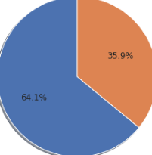
AcctAge
DDABal
Checks
NSFAmt
SavBal
ATMAmt
POSAmt
CDBal
InvBal
LOCBal
CRScore
21
ILSBal
MMBal
MTGBal
CCBal
IRABal
Income
LORes
HMVal
DepAmt
Age
Customer Data
Continuous Variables
POS
CD
IRA
ILS
MM
MTG
CC
CCPurc
SDB
HMOwn
MMCred
LOC
Res
Dep
Inv
Moved
InArea
Branch
DDA CashBk
DirDep
NSF
Phone
Teller
Sav
ATM
0
1
26
Categorical Variables
Target Variable
-Insurance Product

Slide 8
DATA PRE-PROCESSING
Data Cleaning
Feature
Engineering
Feature Analysis

Slide 9
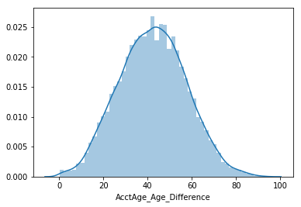
Data Cleaning
Categorical
variables
Continuous
variables
Using Mode of the categories
Using KNN via Impute
65125
Missing values
Missing values for variables except Age were replaced by their respective means, excluding outliers.
For Age the missing values = AccAge + 43 (difference between the AcctAge and Age)

Slide 10
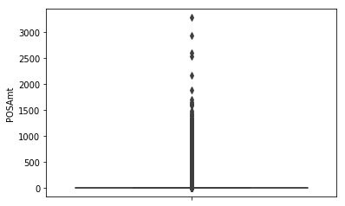
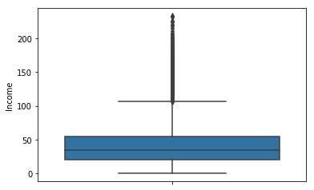
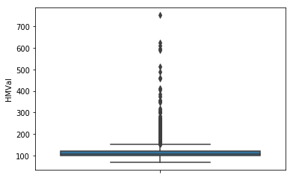
Outliers Detection
We detected outliers using Box-Plots and Isolation Forest and the rows showing significant deviation were removed.

Slide 11
Feature Engineering
New Features
HasAccount =DDA + Sav + IRA + MM
Assets
=DDABal + SavBal +CDBal +IRABal + MMBal + Income + HMVal
+ DepAmt + InvBal -NSFAmt - ILSBal - MTGBal - CCBal

Slide 12
Feature Selection
Two sample t-test: Alternative Hypothesis is accepted
Kruskal Wallis H- test
Continuous Variables
Variables | P values
LOCBal | 0.921
CRScore | 0.333
ILSBal | 0.053

Slide 13
P-values of chi-square t-test for various features
Variables | P-Values
ILS | 0.006
MTG | 0.961
CC | 4.646e-118
CCPurc | 7.839e-36
HMOwn | 0.922
Moved | 0.421
InArea | 3.232e-26
Branch | 3.378e-67
Res | 0.090
Inv | 2.206e-59
HasAcc | 2.362e-219
LOC | 0.624
Categorical Variables
Contingency Chi-square t-test
If the observed chi-square test statistic is greater than the critical value, the null hypothesis can be rejected.

Slide 14
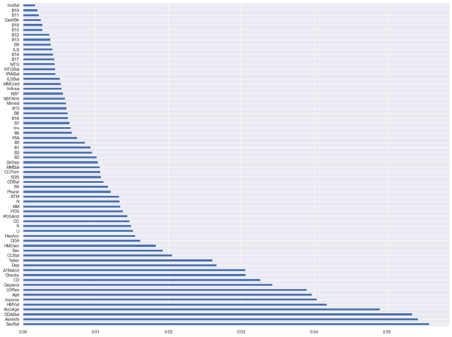
Extra Tree Classifier
For both Continuous and categorical Variables

Slide 15
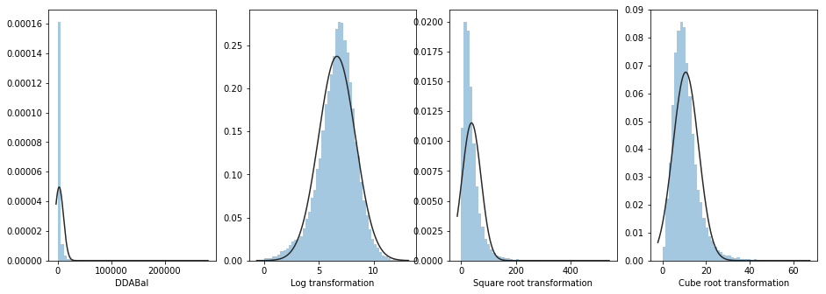
Feature Analysis
The features like Checks, DDABal appear to be very skewed. Hence, we use different transformations(BoxCox) and logarithmic, square root, cube root and selected the log as it gives the most standardized distribution.

Slide 16
MACHINE LEARNING MODELS

Slide 17
Random Forest Classifier
Extra Tree Classifier
Light GBM
Gradient Boosting
Cat Boost
Bagging
SVC
Naive Bayes
Logistic Regression
MODELS TRAINING

Slide 18
Random Forest Classifier
PROS
CONS
It is robust to outliers (which are many in number in our case)
It is also indifferent to non-linear data
Each Decision Tree has high variance, but low bias. But because we average over all trees, we have low bias and moderate variance model
It can tend to overfit and hence needs parameter tuning

Slide 19
XGBoost Classifier
PROS
CONS
It has inbuilt capability to handle missing values
Model interpretability: It appears to be a blackbox and is very difficult to be interpreted

Slide 20
Cat Boost
PROS
CONS
It has the flexibility of giving indices of categorical columns so that it can be encoded as one-hot encoding using one_hot_max_size.
CatBoost uses an efficient method of encoding which is similar to mean encoding but reduces overfitting.
CatBoost performs well only when we have categorical variables in the data and we properly tune them and has little or no effect on continuous variables.

Slide 21
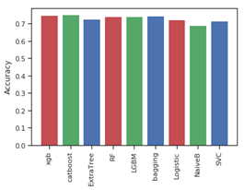
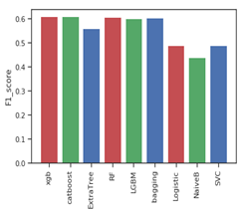
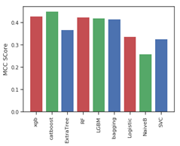
Results
Model | Test Accuracy | F1 Score | MCC Matthew Correlation Coefficient
Cat Boost | 0.753 | 0.610 | 0.45
XGBoost | 0.75 | 0.609 | 0.428
Random Forest | 0.748 | 0.608 | 0.424

Slide 22
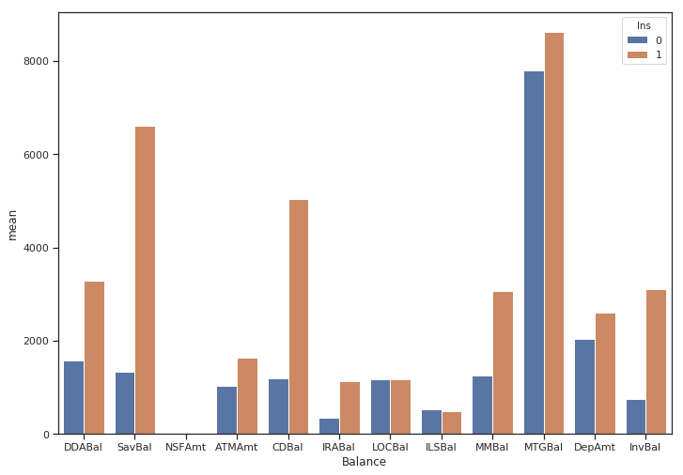
Business & Marketing Insights
DDABal
From our analysis on the data, we find few of the features very important from the business perspective as these are important in determining if the customer is a potential buyer of the insurance product which is a permanent disability product with a low monthly premium.
CDBal
SavBal
MMBal

Slide 23
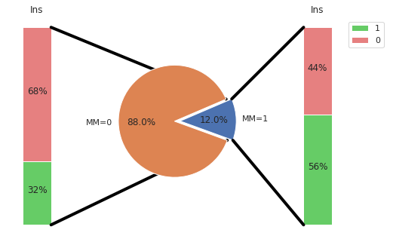
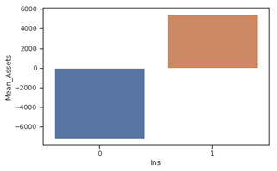
Business Insights
MM
People associated with Money Market have a higher chance of being a potential customer.
Phone
Greater the number of phones lesser is the chance of being a potential candidate.
Assets
People with positive value of assets are our potential buyers

Slide 24
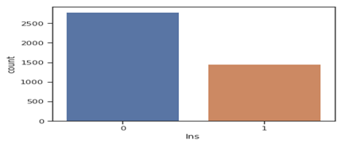
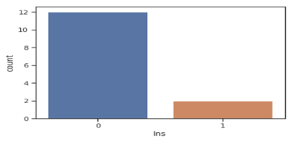
Business Insights
Customers having no Home, that is HMOwn = 0 and age < 45 are not potential customers.
Customers having no Income, that is Income = 0 and age < 45 are not potential customers.

Slide 25
1
People with positive Assets and age greater than 45.
Who are the most potential buyers?
2
People already investing in Money market and with less count of phones.
3
Young people with 0 Income and who doesn’t own home should not be considered.

Slide 26
Thank you

